Slide 1
The mitochondria is the powerhouse of the cell.
Augmented Reality Classroom
Caroline Law, Iszzy (The Boss) Hennes,
Hasham Mukhtar, Ajinkya Gavane

Slide 2
Weekly Update
We currently have a 3D model built in maya, and most of the assets created for the final product.
Currently, we need to test to make sure the colors of the text do not clash with the real world, and make sure we get the dimensions of all of the assets correct.
We are attempting to design the app for both the Epson Moverio glasses and for a mobile device using Unity.
- Main Problem: The Epson Moverio Model BT-350 is not compatible with Vuforia. There are no tutorials or instructional information for the Unity plugin for the Epson Moverio BT-350, and the support website is in Japanese.

Slide 3
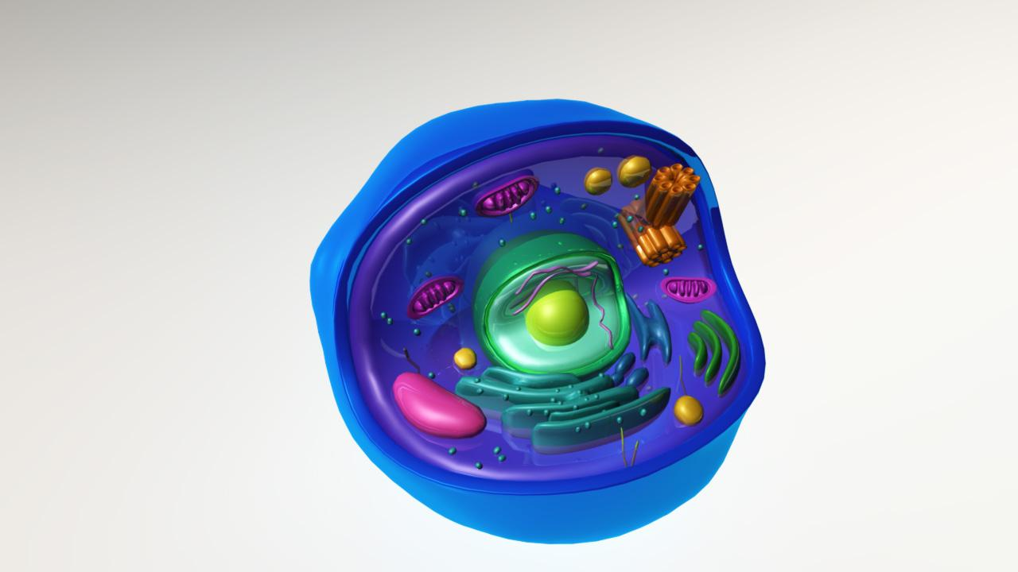
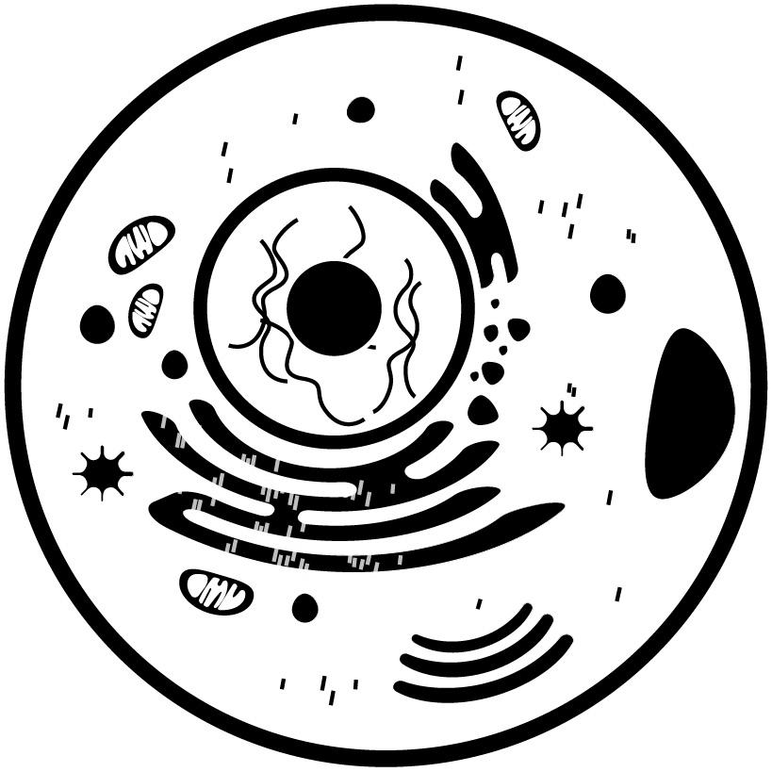

Slide 4
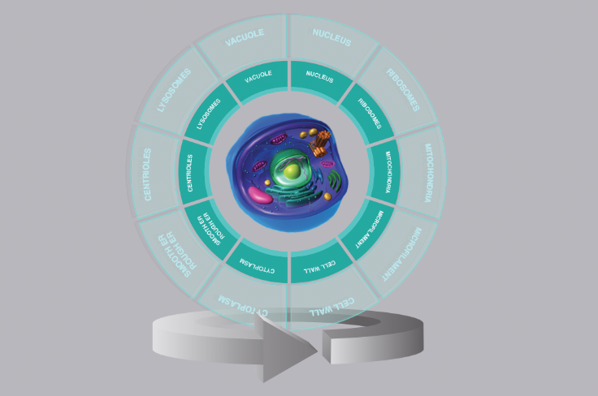
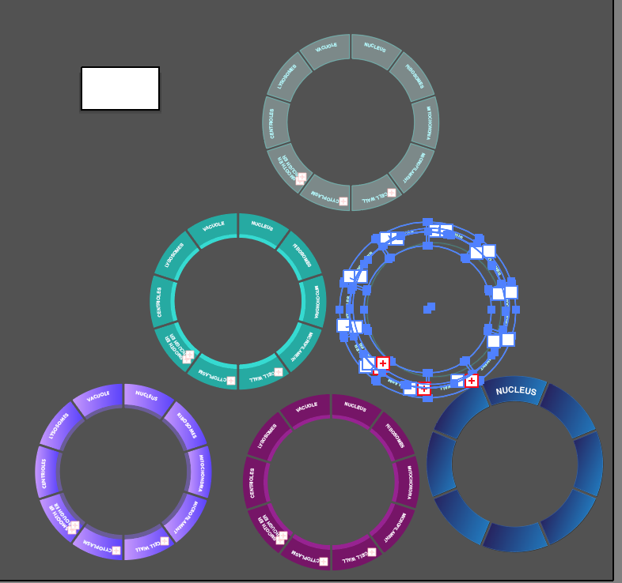

Slide 5
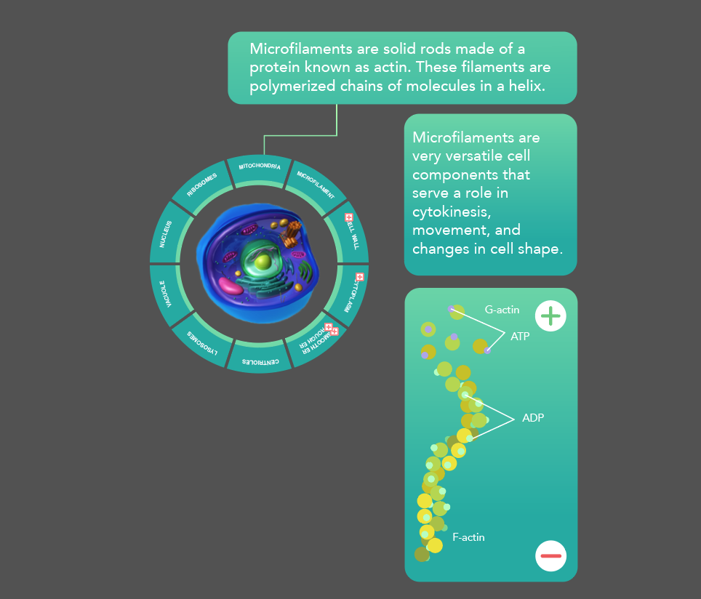
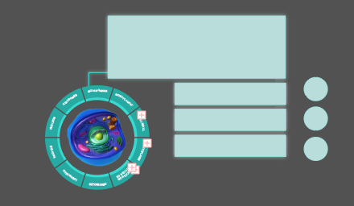
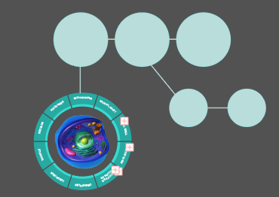
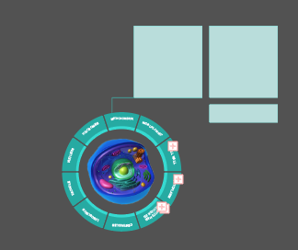

Slide 6
